Slide 1
Iterator, Composite, and Visitor
CS350/SE310 Fall 2015

Slide 2
A new problem: the Store Merger project

Slide 3
Merging store catalogs
StoreA and StoreB are merging into a single company
They both have their own Internet catalog
Info kept in different types of data structures
They want to present their unified catalog in the new SuperStoreAB e-commerce portal
They want to:
Maximize re-use
Minimize disruption to existing code on both sides

Slide 4
SuperStoreAB Architecture
Typical web-based 3-tier business application
but with 2 back ends
and a business logic mid-tier
The mid-tier is the Client for the 2 catalogs
DBMS A
DBMS B
Business logic
Customer
browser

Slide 5
Integration problem
Both catalogs implemented with Java data structures
But …
StoreA keeps catalog items in an ArrayList
itemsA = new ArrayList();
StoreB keeps catalog items in an array
Item[] itemsB;
itemsB = new Item[MAX_ITEMS];

Slide 6
What is an Item?
Item keeps the following info:
Name
Description
Price

Slide 7
Integration problem
None of the two stores want to change their Java collections
Too much legacy code depends on their previous choices
The mid-tier must iterate over two different types of collections to return a Web page showing the integrated catalog
for (i=0; i<itemsA.size(); i++){
Item myItem = (Item) itemsA.get(i);
System.out.println (myItem.getName());
…
}
for (i=0; i<itemsB.length; i++) {
Item myItem = itemsB[i];
System.out.println (myItem.getName());
…
}
Can we encapsulate
what varies?

Slide 8
Iterating over a collection
Haven’t we seen this already …
… a unified abstraction for traversing collections
An Iterator!

Slide 9
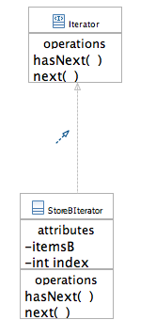
StoreBIterator
We need to develop it because arrays don’t have Iterators built-in
public class StoreBIterator implements Iterator {
private Item[] itemsB;
private int index = 0;
public StoreBIterator(Item[] theCatalog) {
itemsB = theCatalog;
}
public Object next() { return itemsB[index++]; }
public boolean hasNext() {
return (index < itemsB.length &&
itemsB[index] != null);
}
}

Slide 10
Refactored code
Iterator storeAIter = itemsA.iterator();
Iterator storeBIter = new StoreBIterator(itemsB);
outputCatalog(storeAIter);
outputCatalog(storeBIter);
…
private void outputCatalog(Iterator iter) {
while (iter.hasNext()) {
Item myItem = (Item) iter.next();
System.out.println(myItem.getName());
…
}
}
Contrast with old code:
for (i=0; i<itemsA.size(); i++){
Item myItem = (Item) itemsA.get(i);
System.out.println (myItem.getName());
…
}
for (i=0; i<itemsB.length; i++) {
Item myItem = itemsB[i];
System.out.println (myItem.getName());
…
}

Slide 11
Observations
Before:
Catalogs not well-encapsulated
Two loops with code repetition
mid-tier programmed to concrete classes, not interface!
After:
Catalogs implementation hidden from mid-tier
One (polymorphic) loop
Programming to the Iterator interface!

Slide 12
Complete Iterator pattern structure

Slide 13
The Iterator pattern
Classification:
Behavioral purpose; object scope
Context: Enables traversal of elements in an Aggregate without exposing the Aggregate Implementation
Problem: Depending on the data structures underpinning an Aggregate, you must access its elements in different ways
Solution: Places the responsibility of traversal on an Iterator object.
Consequences:
Supports multiple ways to traverse an Aggregate (simply change the Iterator object)
You can have multiple traversals at the same time
Iterators simplify the interfaces of Aggregates (relieve the burden of making traversal methods available)
Separates responsibilities

Slide 14
Embracing more changes
What if SuperStoreAB acquires another Store?
Store C?
What changes?
(besides the name of the company!)
Say Store C uses a HashTable data structure for items
[ID ---> Item]

Slide 15
What changes?
Create a ConcreteAggregate for Store C
createIterator() method
Make available an Iterator object for the Store C data structure
ht.values.iterator();
Modify the Client to accommodate:
Instantiation of Store C Iterator
traversal of Store C catalog via that Iterator

Slide 16
Improving the Open-Closed principle
Your solution?
What about a Collection of Catalogs?
with a catalog Iterator?
1st level: iterate on Catalogs
2nd level: for each Catalog, iterate on its Items
Will it work?
Yes … for now

Slide 17
SuperStores have many levels
Any self-respecting SuperStore cannot have flat catalogs!
Will have many Departments
Will need to split its items in many separate Department catalogs
How many levels of Aggregates within Aggregates?

Slide 18
Example
SuperStore
StoreA
StoreB
StoreC
Dept1
Dept2
Dept1B
Dept2B
Dept1C
Dept2C
Item
Item
Item
Item
Item
Item
Item
Item
Item
Item
Item
Item
Item
Item

Slide 19
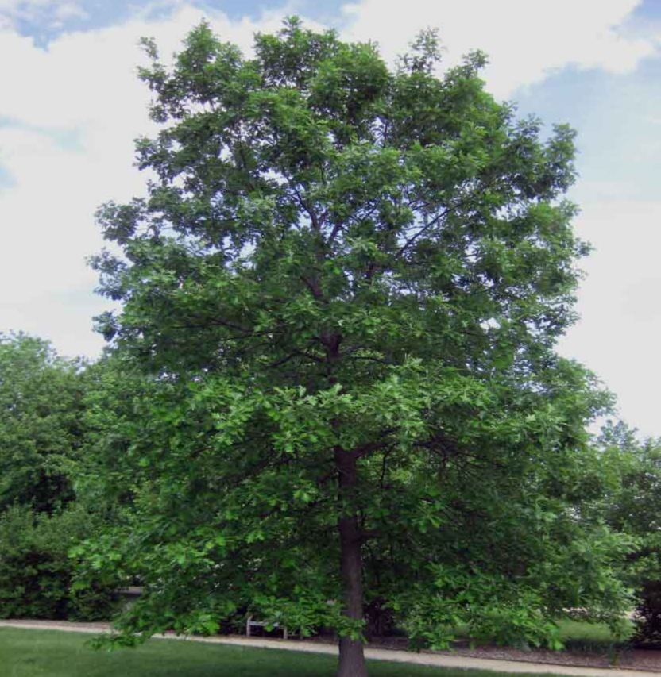
A Traditional Tree

Slide 20
The Composite pattern

Slide 21
Composite pattern - structure
Interface for
A top-level catalog;
A dept. catalog
An Item
An Item (atomic)
Either a top-level or a dept. catalog

Slide 22
Composite pattern - participants
Component: abstract class
Defines default behavior for operations that have to do with handling the structure of the composition
Declares, abstract, other common behaviors
Composite:
Has children
Implements structure-handling operations
Also implements behaviors
Leaf:
No children, atomic element
Only implements behaviors
Must not support structure-handling operations
Although it has inherited them

Slide 23
The Composite pattern
Classification:
Structural purpose; object scope
Context: Manages part-whole hierarchies as tree structures.
Problem: You want to represent and handle nodes of a tree uniformly, independently from their nature (sub-trees or leaves)
Solution: Uses inheritance to define uniform abstraction for both types of nodes.
Consequences:
Provides way to compactly define part-whole hierarchies
Treats everything uniformly; makes client’s life simple
Overly-general design: Leaf does not support Composite-handling methods

Slide 24
Patterns team-up
Composite and Iterator
How do they work together?
Where would you use an Iterator in the Composite pattern?
What is an Aggregate in this pattern?

Slide 25
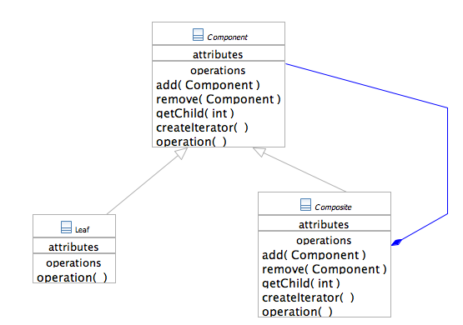
Composite and Iterator
What about the
Single Responsibility
Principle, Dependency inversion principle?

Slide 26
Store Printing
To print the whole catalog of items
Top to bottom
All elements in the Composite pattern must expose the print() operation
For leaves it prints a set of data related to each Item
Will see in a bit
For sub-tree elements: name of that element
And iterate on its sub-tree

Slide 27
Composite critique
OK, so it helps with whole-part trees …
Provides uniformity to clients
Transparency with respect to what and where
But … it forces that uniformity on all elements in the whole-part
Leaves are “polluted” with structure-handling operations
What if the application-level operations in different parts of the tree should be different?

Slide 28
Example
SuperStore
StoreA
StoreB
StoreC
Dept1
Dept2
Dept1B
Dept2B
Dept1C
Dept2C
Item
Item
Item
Item
Item
Item
Item
Item
Item
Item
Item
Item
Item
Item

Slide 29
Example
At the leaf level - Items
Retrieve description
Compute unit price (perhaps with discount)
At the department level what makes sense is different:
Compute what is in stock
Compute revenues
Assume that we store the necessary info in the appropriate classes
Same thing (cumulative) at the store level

Slide 30
Adding and changing behaviors
Problem: we have the Composite structure in place and we don’t want to throw it away
We want to add application-level methods as needed in various parts of the tree
NOTE: adding methods for all needed functionality in Component super-class won’t work
And would further “pollute” classes
Very poor cohesion
What would you do?

Slide 31
Do you remember Decorator?
Adds behaviors to unsuspecting objects
The problem here is that the behaviors are not already defined in the target object
We need a more dynamic way to adding behaviors
Depending on where we are in the tree traversal
Two cases:
Item (i.e. Leaf)
Dept. or Store (i.e. Composite)

Slide 32
The Visitor pattern

Slide 33
What is a Visitor?
A Visitor is an object that “is applied” to an element in a complex object structure
Such as a Composite hierarchy
Depending on the type of the object it is applied to, the Visitor will execute certain operations
The target object must “accept” the Visitor

Slide 34
Visitor pattern - structure

Slide 35
Visitor - participants (1)
Object structure: it is the overall set of objects
a Composite
a Collection
In our example: the whole SuperStore tree
Element: abstraction for all types of elements in the object structure
Defines the accept(Visitor) operation
In our example: the Component common interface
ConcreteElements: implement accept(Visitor), by calling the appropriate method in their Visitors
In our example: Stores and Departments, or Items

Slide 36
Visitor - participants (2)
Visitor: interface that declares specific operations for the various types of elements to be visited
ConcreteVisitors: implement the Visitor interface with sets of cohesive algorithms that account for different visit purposes
Those algorithms make use of functionality of the visited elements
Examples:
ConcreteVisitorA for accounting purposes
ConcreteVisitorB for stocking and logistic purposes

Slide 37
Visitor - interactions
objectStructure
concreteElemA
concreteElemB
concreteVisitor
accept(concreteVisitor)
visitConcreteElementA(this)
operationA()
accept(concreteVisitor)
visitConcreteElementB(this)
operationB()

Slide 38
The Visitor pattern
Classification:
Behavioral purpose; Object scope
Context: When you need to extend or differentiate what an application does upon different elements contained in the same polymorphic “object structure”
Problem: lets you define new operations without changing the classes of the visited elements in the object structure
Solution: Visitor executes the right algorithm for each type of element that it finds while traversing the object structure
Consequences:
some benefits …
… and some drawbacks

Slide 39
Visitor Benefits
Makes it easier to extend elements with new and diverse operations
Each Visitor is cohesive unit
Visitors can accumulate state as they go
Visitors are more flexible than Iterators because they can traverse and operate upon multiple types of objects

Slide 40
Visitor Drawbacks
Adding new types of ConcreteElements breaks the Open-Closed principle:
impacts code of all ConcreteVisitors
requires change also to the top Visitor interface
The Composite classes encapsulation may need to be weakened
to allow the Visitor to tap onto the data and functionality of the Element it visits

Slide 41
Homework recap
The application of visitor pattern
The difference between Question creation and Question printing
Design principles
Information hiding
Data encapsulation
Dependency inversion principle recap

